Slide 1
Block Diagram
Data collection
Data preprocessing
Model training
Front-End Interface
Prediction

Slide 2
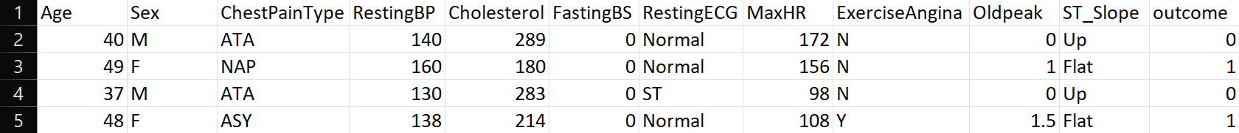
Data Collection
Source : The dataset was sourced from Kaggle, a popular platform for machine learning datasets and competitions.
Description: This dataset includes various features related to heart disease diagnosis, such as age, cholesterol levels, and exercise habits.
Link: [Heart Disease UCI Dataset on Kaggle] (https://www.kaggle.com/datasets)

Slide 3
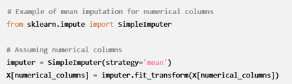
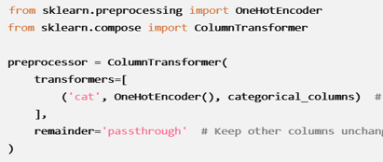
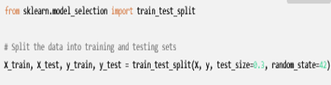
Data Preprocessing
Steps Involved:
- Handling missing values.
- Encoding categorical data
(gender)
- Splitting into training
and testing datasets
- Libraries Used: Pandas,
Scikit-learn, NumPy, Matplotlib

Slide 4
Choosing the Best Model

Slide 5
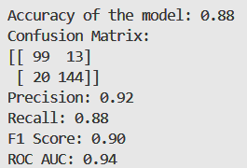
Machine Learning Model Overview
Model Selection: Random Forest model uses decision trees and bagging to analyze data. It can handle large data sets and thousands of input variables.
Training Process: Train model on health indicators to predict heart disease risk.
Correlation Analysis: Features influencing the model's predictions significantly.
Evaluation Matrix: Accuracy, Precision, Recall, F1-score

Slide 6
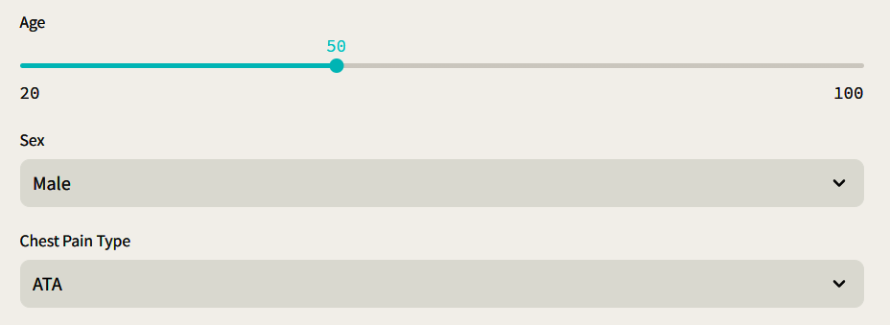
Front-End Implementation (Streamlit)
• Overview: User inputs health indicators, model returns risk prediction
• Key Code Snippet: Interactive elements (input fields, sliders, buttons)
• Explanation: How users interact with the app

Slide 7
Model Integration with Streamlit
• Process Flow: User inputs → Preprocessing → Model Prediction → Display Results
• Real-time Prediction: Streamlit calls trained model for real-time prediction
• Dynamic Display: Showing prediction results and suggestions

Slide 8
Challenges & Improvements
• Challenges:
- Data collection and quality
- Model accuracy and generalization
• Future Enhancements:
- Including more health parameters
- Improving accuracy with advanced models
- Personalized recommendation

Slide 9
Use of Project
• Practical Application: Early prediction of heart disease risk
• Impact: Empowering users with AI-driven insights to prevent heart disease
• Long-term health benefits and reduction of cardiovascular disease rates

Slide 10
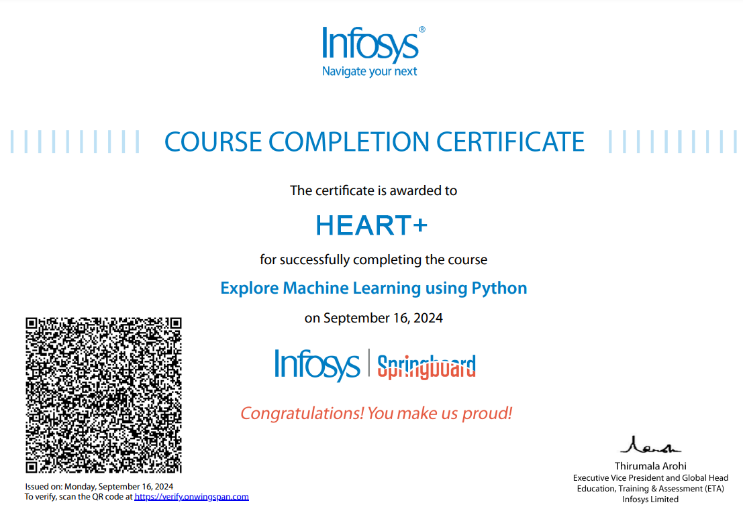
Proctored course
Via Infosys springboard –
Machine Learning Foundation Certification
Explore Machine Learning using Python

Slide 11
Project no. - NJ2
Group members-
Shreya Sharma (221b370)
Paras Jain (221b260)
Vishvajeet Adavkar (221b450)

